Slide 1
CLINICAL OUTCOME IN PATIENTS UNDERGOING MICROSURGERY OF LUMBAR DISC HERNIATION AND SPINAL STENOSIS – A PROSPECTIVE STUDY
Authors: Sibilla Elisona Griga
Scientific research supervisor: Karlis Purins MD PhD

Slide 2
OBJECTIVES / INTRODUCTION
Lumbar back pain is critical issue in healthcare, often causing disabilities in working- age group.
The Oswestry Disability Index (ODI) is eminent assessment instrument, relying on patients subjective experience.
This clinical study is based on surgical intervention suitability and advantages.
Using ODI and Numeric Rating Scale (NRS) questionnaires, assessments are conducted preoperatively, at six months and one year postoperative.

Slide 3
MATERIALS AND METHODS
Fifty-one patient (mean age 54 years) with typical symptoms of LDH (lumbar disc herniation) and LSS (lumbar spinal stenosis) were included.
The data were collected between (year 2021-2022), who underwent micro-spinal surgery.
The main criteria – preoperative diagnosis, age, gender, results in ODI (points, percents) including NRS, before surgery, 6 months and 1 year after surgery.
Patients were divided into 2 groups by diagnosis – LDH (n=31) and LSS(n=20).
This study was approwed by RSU Research Ethics Committee (2-PĒK-4/259/2024)

Slide 4
RESULTS
Both groups showed significant reduction in pain and improved the quality of life.
NRS values before surgery LDH: 7 (IQR 6;8) LSS 7 (IQR 6;8) showed no statistical difference [p=0.858].
Six months post-surgery - significant changes were observed NRS for LDH 1 (IQR 0;2) and LSS 2 (IQR 1;2) [p<0.001].

Slide 5
RESULTS
One year follow-up, NRS for LDH 0 (IQR 0;1) and LSS 0 (IQR 0;0) showed no significant differences [p=0.582].
A correlation (r=0.36, p<0.010) revealed higher preoperative ODI percentages associated with higher NRS values.
However, it should be noted that in one case there were two diagnosis – both LDH and LSS, and in one – after 3 months patient had reoperation.

Slide 6
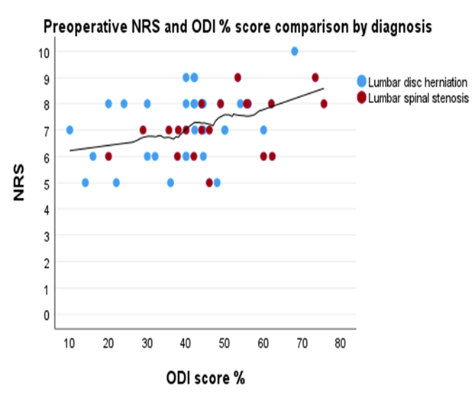
RESULTS

Slide 7
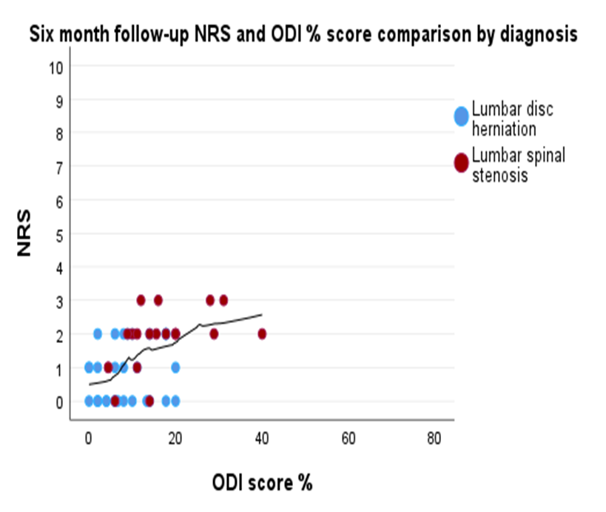

Slide 8
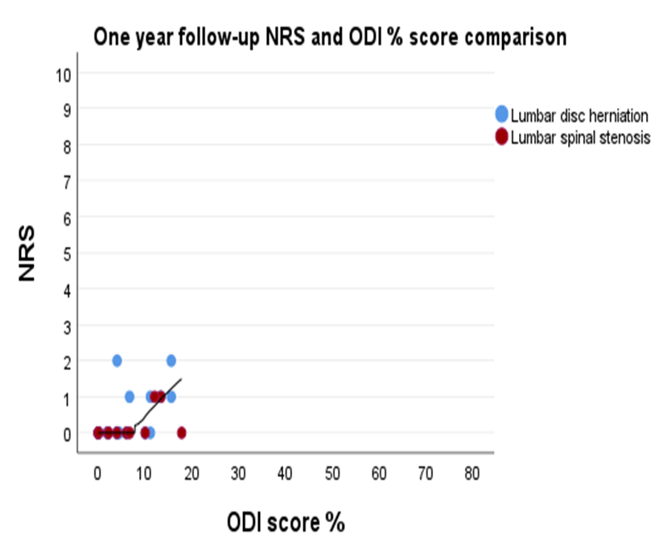

Slide 9
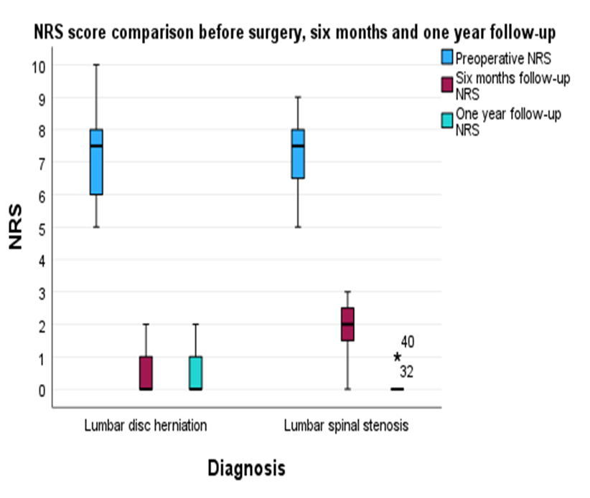

Slide 10
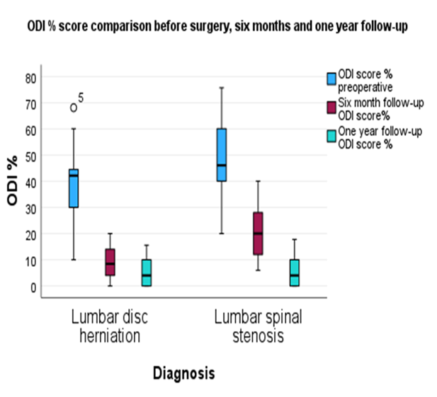

Slide 11
CONCLUSIONS
The results of this study shows a significant reduction of pain and improvement of the quality of life in both patient groups who underwent microsurgery
However, there are significant differences in recovery time – those with disc hernia recovers faster than LSS
Patients treated using microsurgical technique are estimated for fast recovery and significantly improved quality of life

Slide 12
REFERENCES
Ramamurthi,R. (2012). Chapter 109, Pathophysiology of Disc Degeneration, 2432(3) , 1241-1245
Alexander J. Butler; Sunil Munakomi; Chester J. Donnally III, Discectomy (2023), https://www.ncbi.nlm.nih.gov/books/NBK544281/
Brain and Spine, 2022-01-01, Volume 2, Article 100934, Prashant Adhikari, Engin Çetin, Mehmet Çetinkaya, Vugar Nabi, Selcen Yüksel, Alba Vila Casademunt, Ibrahim Obeid, Francesco Sanchez Perez-Grueso and Emre Acaroğlu
Zaina F, Tomkins‐Lane C, Carragee E, Negrini S. Surgical versus non-surgical treatment for lumbal spinal stenosis. Cochrane database of systematic reviews 2016, 1. issue. Art. Nr.: CD010264. DOI: 10.1002/14651858.CD010264.pub2.

Slide 13
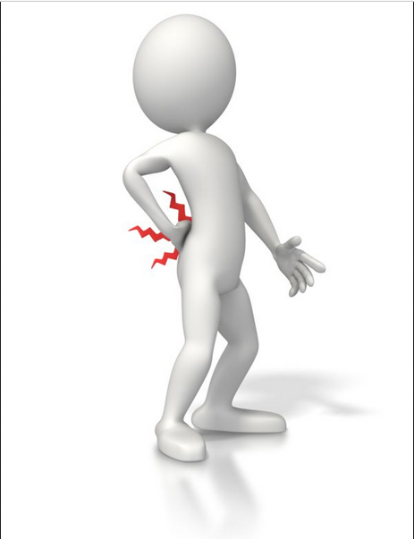
Thank You!
https://content.presentermedia.com/files/clipart/00005000/5228/figure_with_back_pain_800_wht.jpg

