Slide 1
Cauda equina syndrome caused by Aspergillus fumigatus infection – case report
15th Congress of the Baltic Neurosurgical Association
Karlis Purins MD PhD
14 - 15 June 2024

Slide 2
Case report: History
Male – 39 y.o.
Chronic lower back pain syndrome
Otherwise healthy
At the time of admission complains about extreme lower back pain, urinary retention, impotence and cauda equina syndrome
The only known anamnesis is that he was cleaning grain silos with spoiled grain with the purpose of using it to feed wild animals

Slide 3
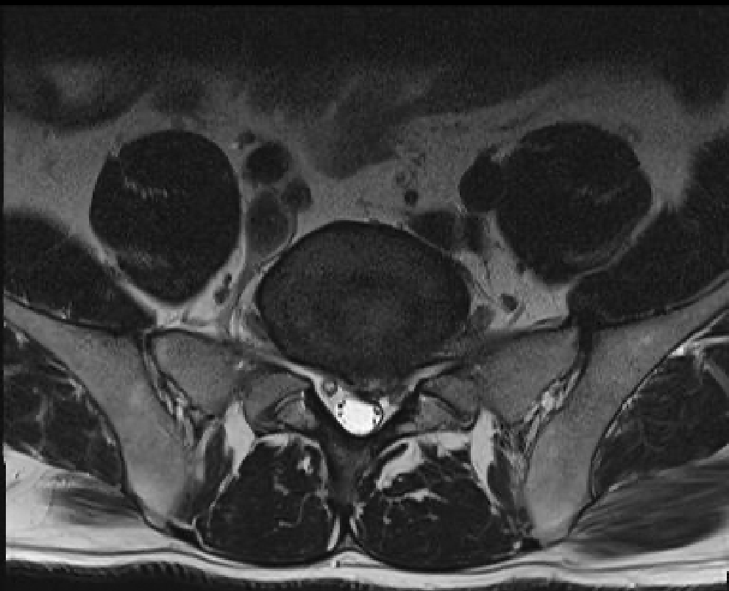
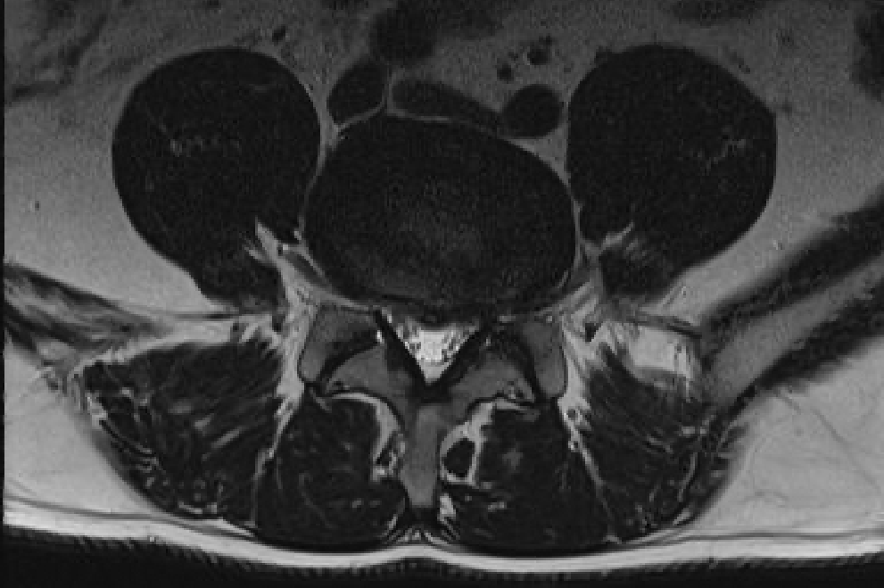
MRI
L5-S1
L4-L5

Slide 4
Lab - pre op
N
CRP – normal (0.83 mg/L)
WBC – normal (7.25 10^{^9}/L)
ESR – normal (2 mm/h)

Slide 5
Treatment
Despite moderate changes in the MRI the clinical presentation is disproportionally more severe
Decision to perform surgery was based upon clinical findings – cauda equina syndrome
Decompression L4 – L5 lateral recess stenosis and microdiscectomy L5 – S1: both on left side

Slide 6
Day 1 – post op
Significant pain reduction
Significant improvement of cauda equina syndrome
Horse saddle numbness disappears
Urination without catheter
Discharged from the hospital in good condition

Slide 7
Readmission – 6 weeks post op
Complains about progressive pain in the lumbar spine
Lab:
CRP 38.8 mg/L
ESR 34.0 mm/h
WBC 7.6 10^{^9}/L
N

Slide 8
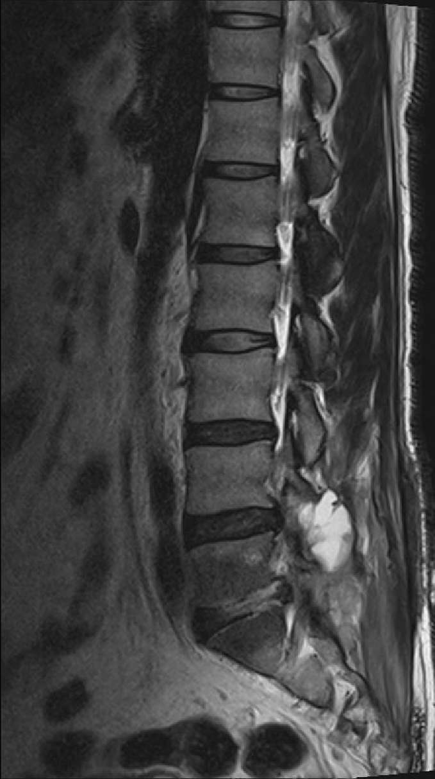
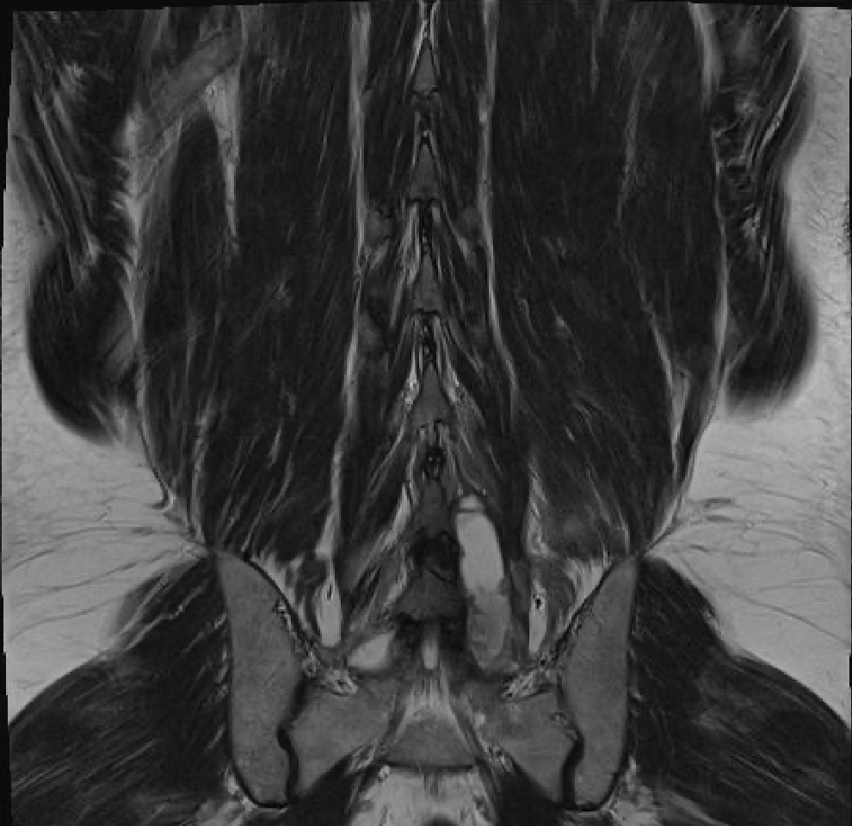
MRI – 6 weeks post op

Slide 9
Re op
Surgery – wound revision
Drainage of the abscess
Microbiology samples

Slide 10
Treatment
Empirical AB treatment
Ceftriaxone 1 g 2x/day
Clindamycin 600 mg 3x/day
Pain killers
Oxycodone 5 mg 4x/day

Slide 11
Treatment 1 week after re op
Despite AB treatment
Lab:
CRP 63.5 mg/L
ESR 50.0 mm/h
WBC 8.9 10^{^9}/L

Slide 12
Microbiology
5 days post op growths of Aspergillus fumigatus
Samples negative for aerobic or anaerobic bacteria

Slide 13
Treatment
Infectious disease specialists recommends:
Cancellation of AB treatment
Antifungal treatment – Voriconazole bolus 400 mg 2x/day for 3 days, continuous dose 200 mg 2x/day for 9 months

Slide 14
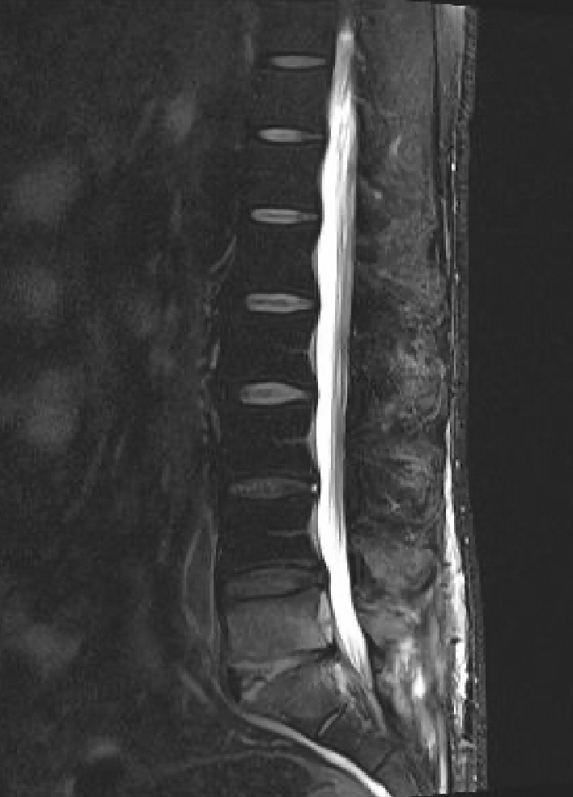
Post op 4 weeks
Lab:
CRP 13.5 mg/L
ESR 8.0 mm/h
WBC 7.3 10^{^9}/L
N

Slide 15
Post op 7 months
Lab:
CRP 1.0 mg/L
ESR 2.0 mm/h
WBC 5.3 10^{^9}/L
N

Slide 16
Clinical presentation 7 months post op
Without lumbar pain – not using any painkillers
Without any cauda equina symptoms
Normal urinary and sexual function

Slide 17
Thank you for attention !

