Slide 1
«One generation passeth away, and another generation cometh; but the earth abideth forever...» ECCLESIASTES

Slide 2
The first Baltic Congress of neurosurgery in Riga
Juris Purins MD PhD

Slide 3
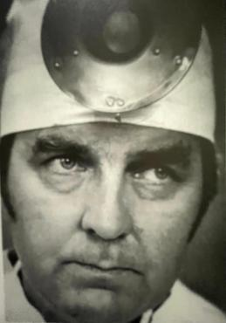
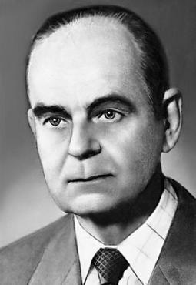
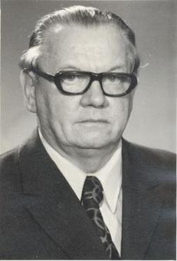
DOC .ILMĀRS PURINS
1927-1977
PROF. LEONAS KLUMBYS
PROF. ERNST RAUDAM
1915- 1992
1921-2010

Slide 4
PAULS STRADINS
HOSPITAL
NEUROSURGERY CENTER
1963
DOC. ILMARS PURINS TEAM

Slide 5
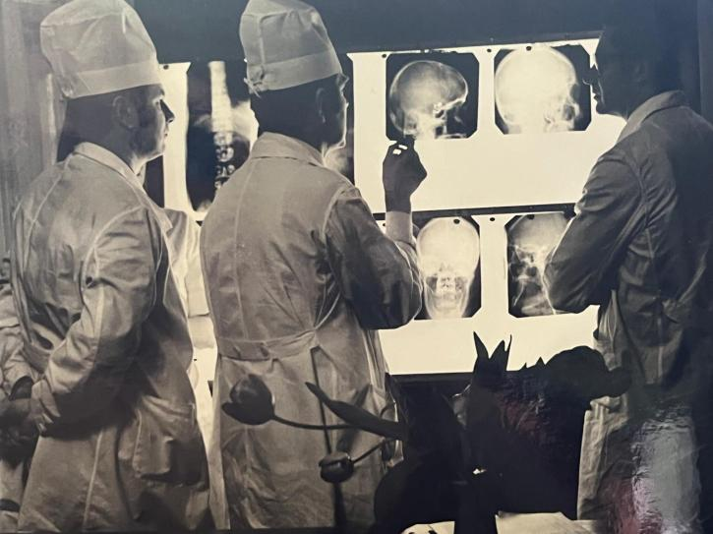

Slide 6
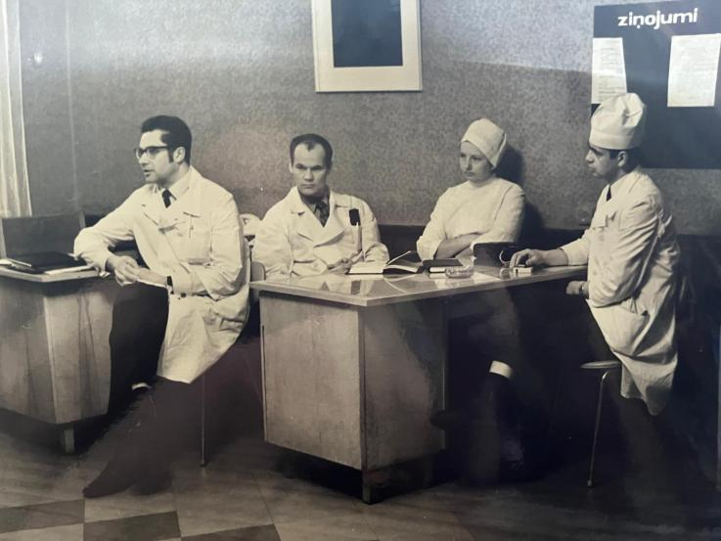

Slide 7
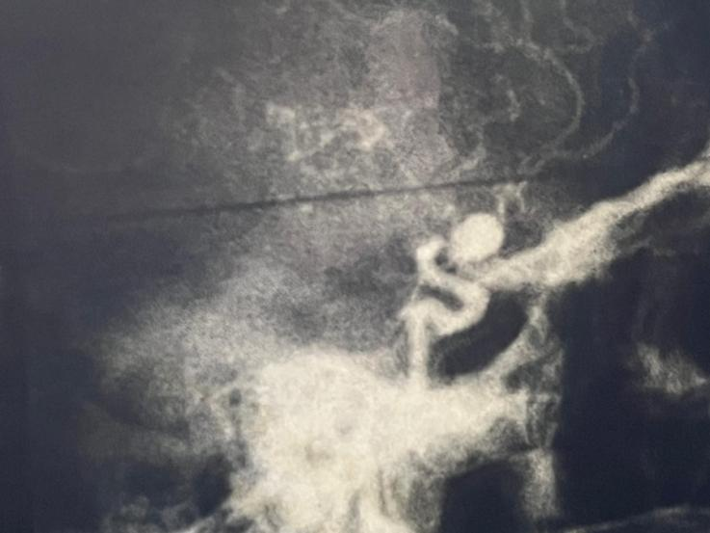

Slide 8
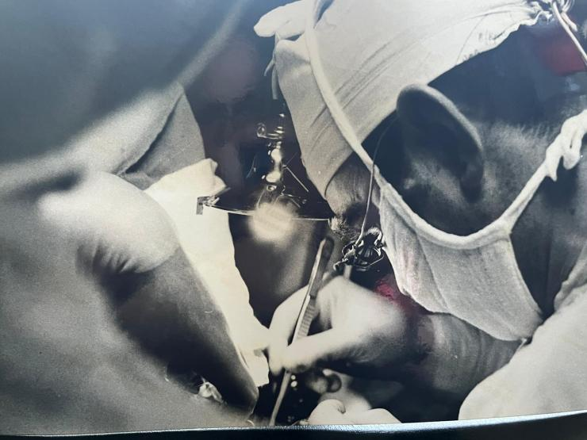

Slide 9
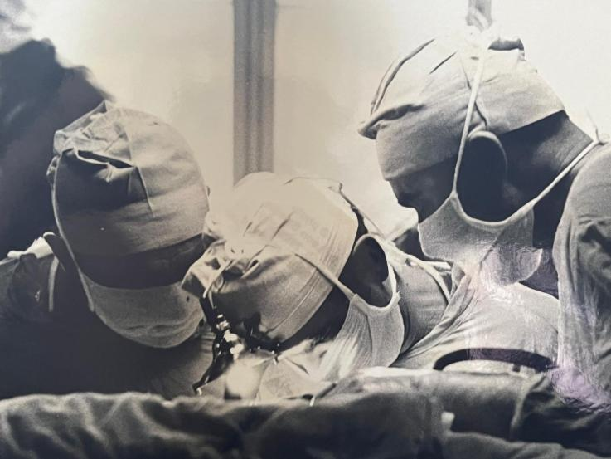

Slide 10
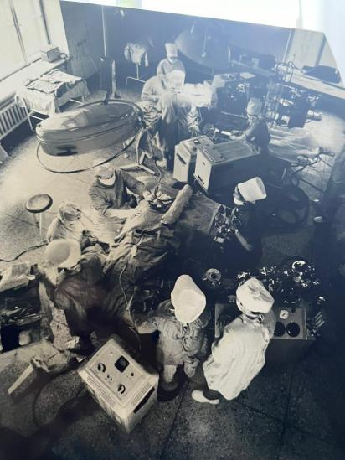

Slide 11
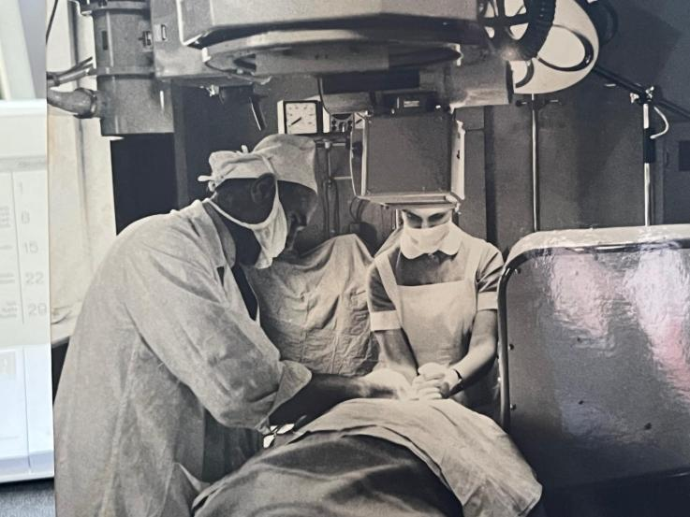

Slide 12
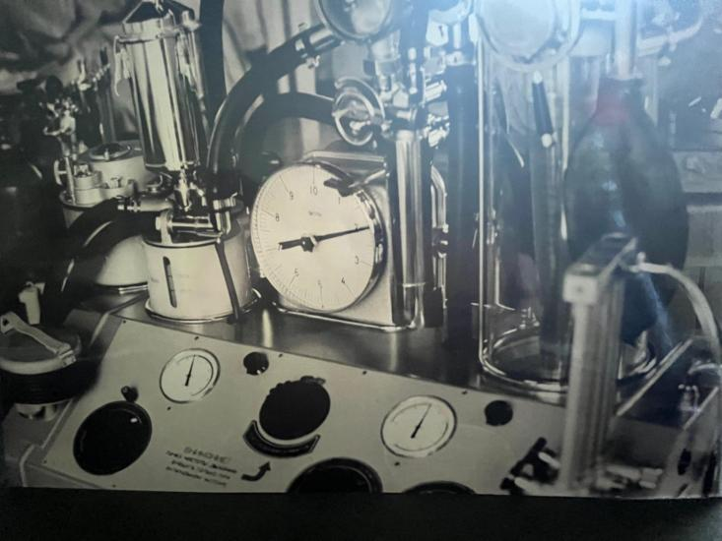

Slide 13
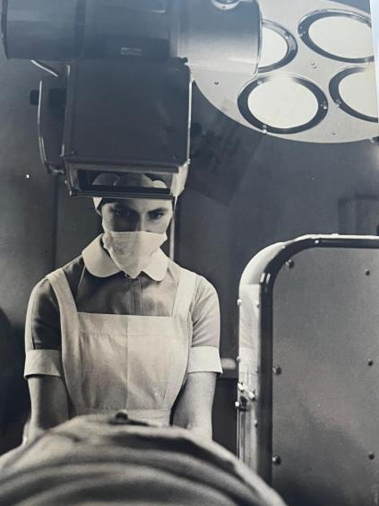

Slide 14
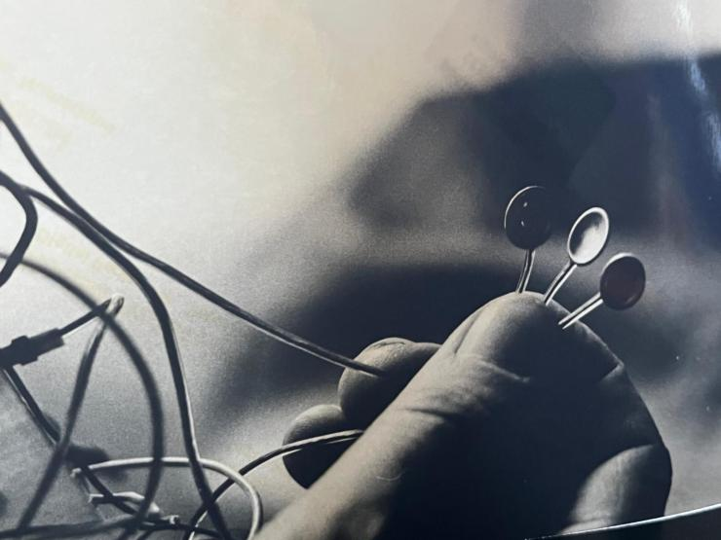

Slide 15
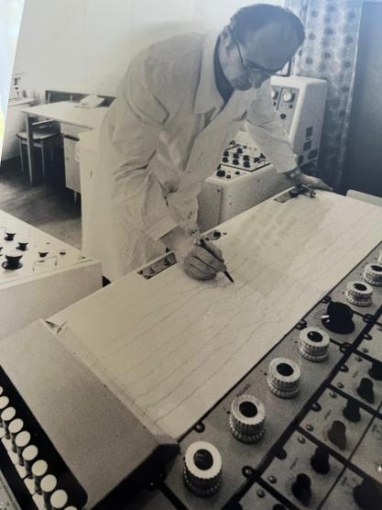

Slide 16
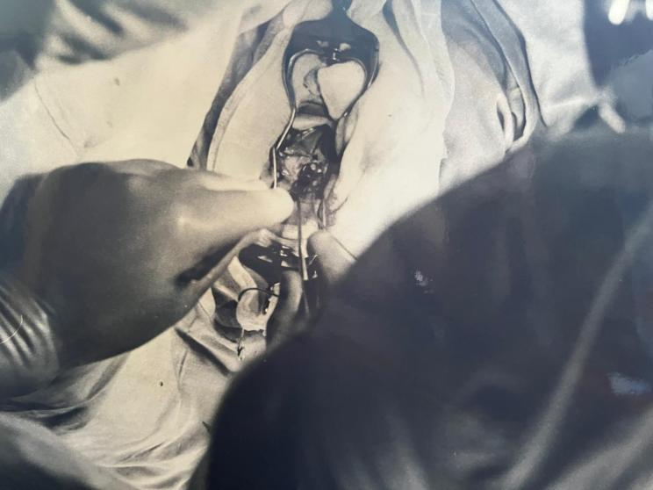

Slide 17
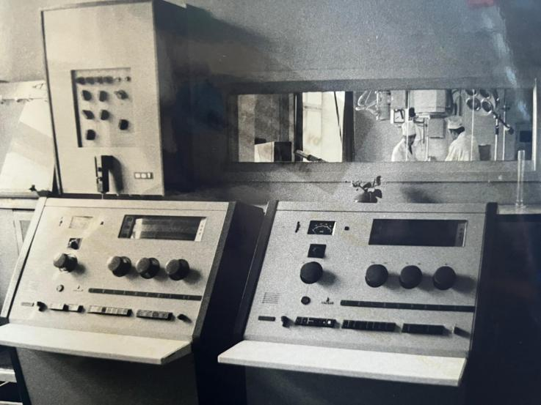

Slide 18
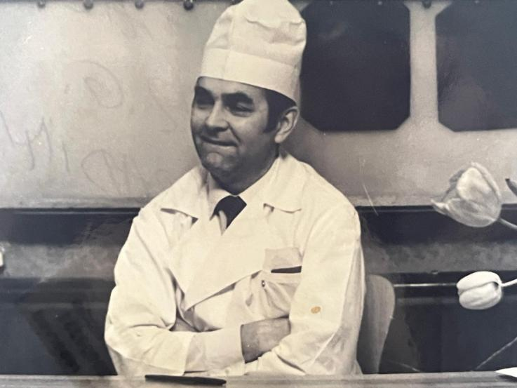

Slide 19
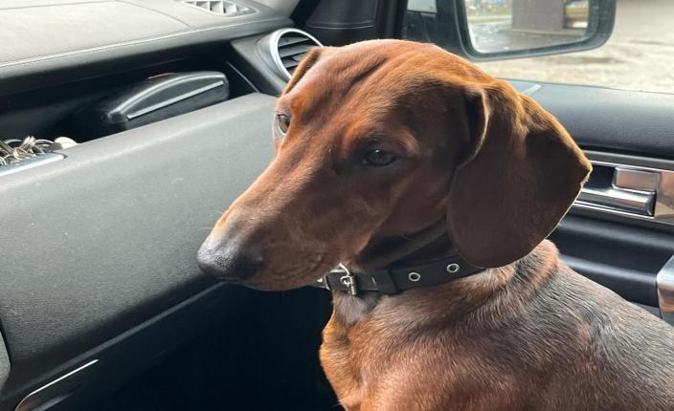
MY BEST FRIEND ROBERTS

Slide 20
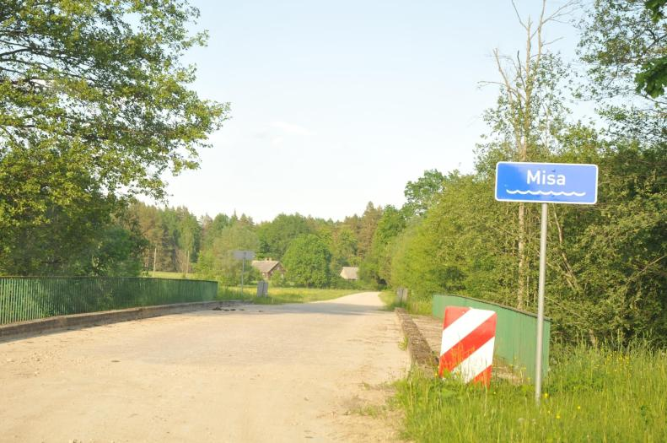

Slide 21
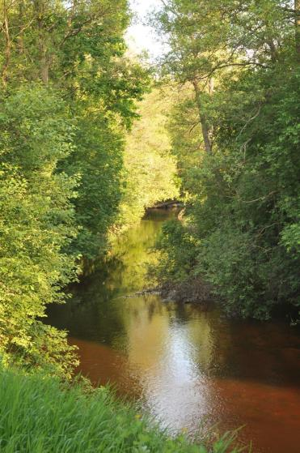

Slide 22
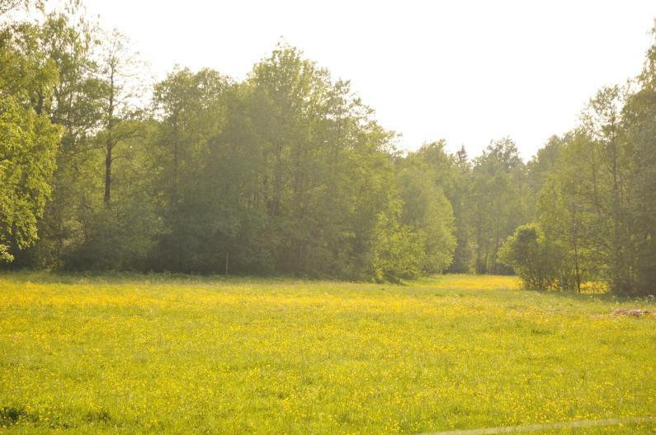

Slide 23
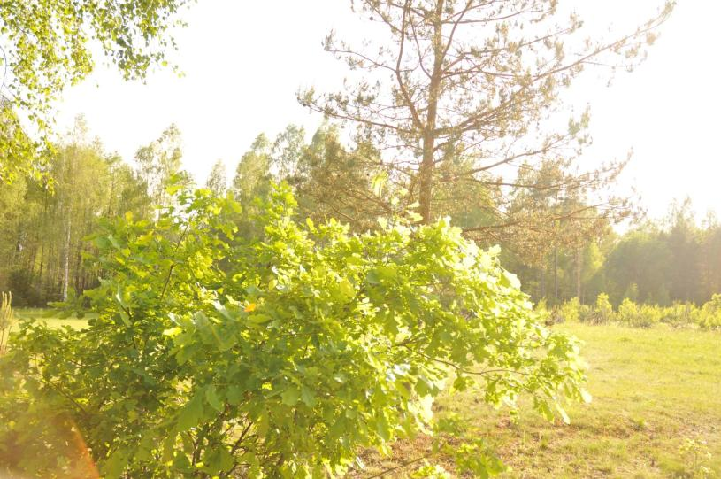

Slide 24
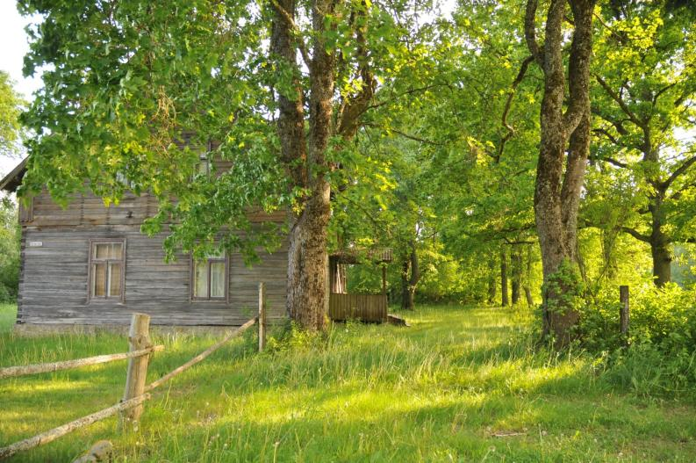

Slide 25
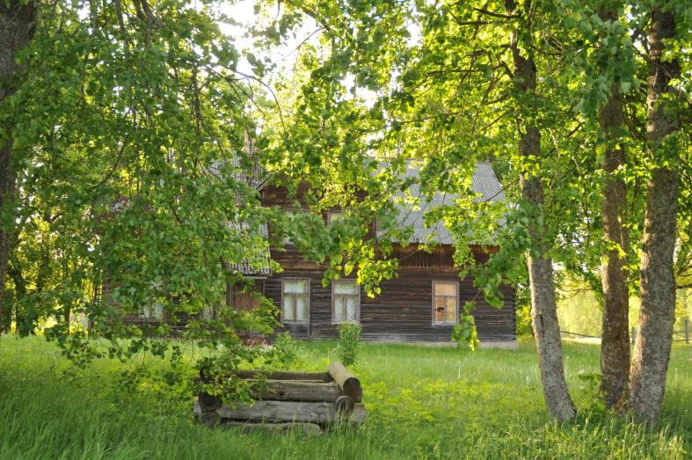

Slide 26
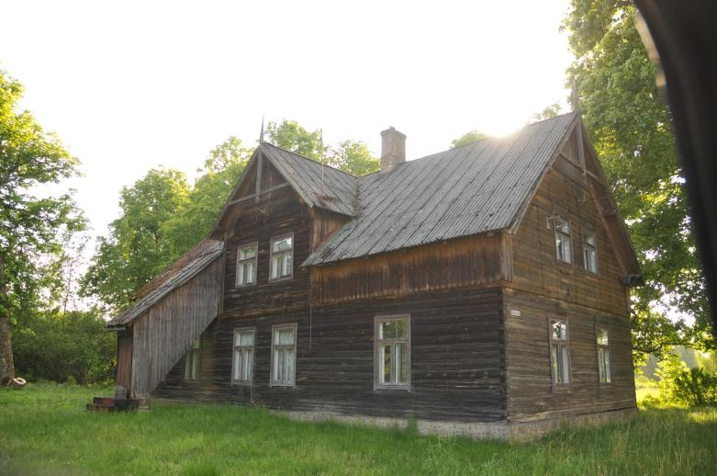

Slide 27
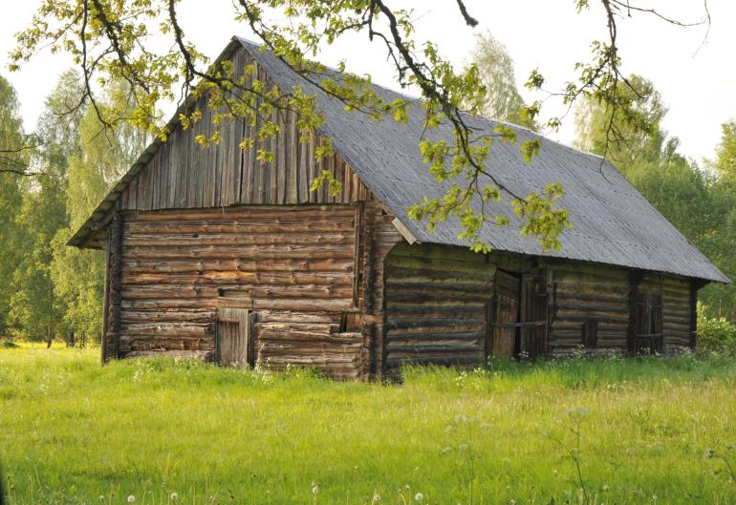

Slide 28
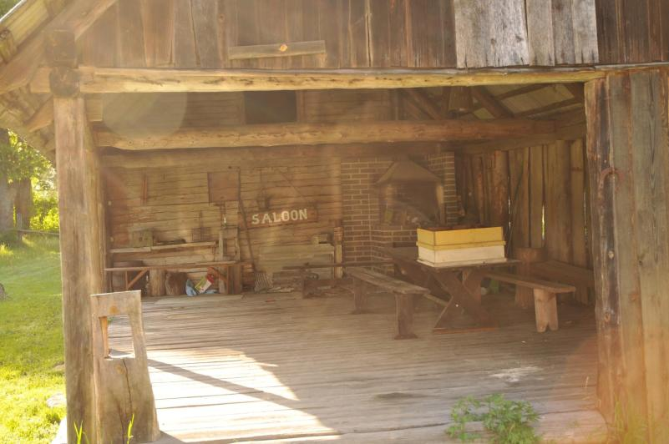

Slide 29
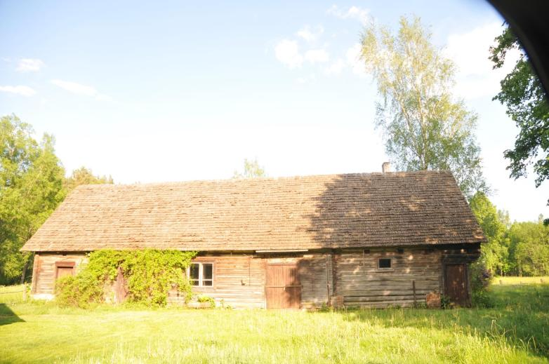

Slide 30
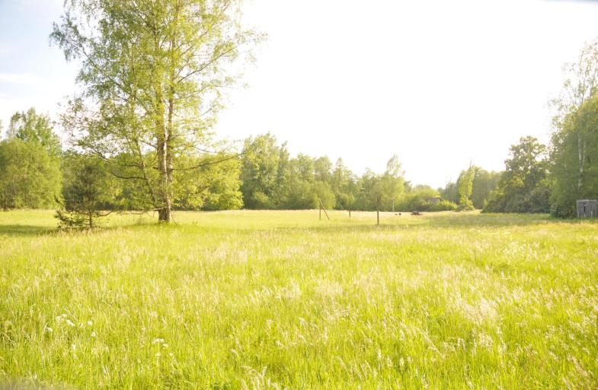

Slide 31
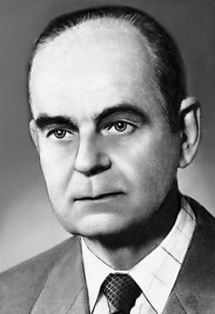
DOC. ILMARS PURINS
1927-1977
PROF. LEONAS KLUMBYS
PROF. ERNST RAUDAM
1915- 1992
1921-2010

Slide 32
Thank you for your attention!

